Slide 1
Green Academy Aarhus
Mathias, Dennis, Line, Emil and Peter

Slide 2
The School
Information
Near the second largest city in Denmark, Aarhus
Founded in 1889
Students and teachers
600 students each year
100 employees
Educations
Landscaping
Gardening
Floristy
Foresting
Agriculture: Farm machinery, animal care and nursery

Slide 3
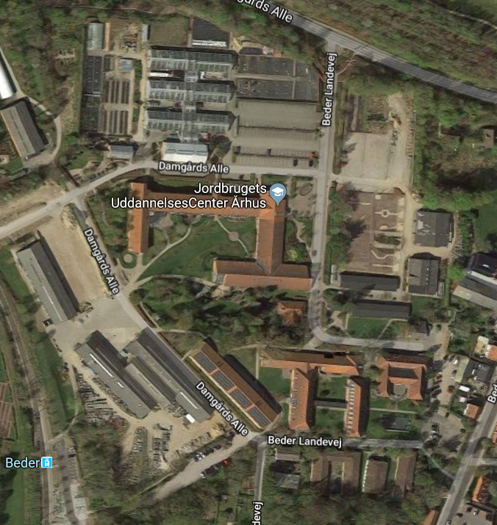

Slide 4
Departments
Beder
Landscaping
Gardening
Floristy
Foresting
Bredballegaard
Farm machinery
Animal care
Nursery

Slide 5
Our interests
Line
Farm animals, dairy cows
Emil
Growing crops
Dennis, Mathias and Peter
Machinery and technology

Slide 6
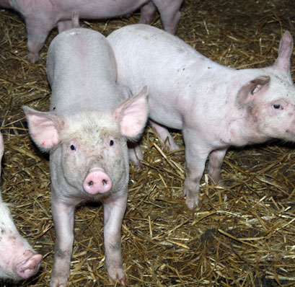
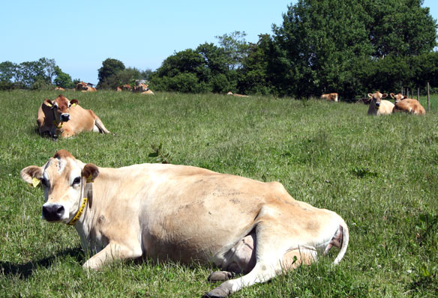
The Collage farm
Animals, machinery and land
Cows
35 Jersey milking cows
Stationary mixer
Milking stable
Pigs
70 fattening pigs
Other animals
Chickens, goats, horses.
Machinery
Tractors
31 tractors
Fendt, Case, Valmet, Internationals, Massey ferguson Mercedes, Claas and Ford
Combine
1 Claas Lexion 405
Equipment
Ploughs, cultivators, roller, windrower, tedder, seeding machines, manure spreader, sprayer, bale trailer and carts
Land
Hectares
30 hecateres
Crops
Wheat, Barley, Corn, and Grass

Slide 7
Bredballegaard

Slide 8
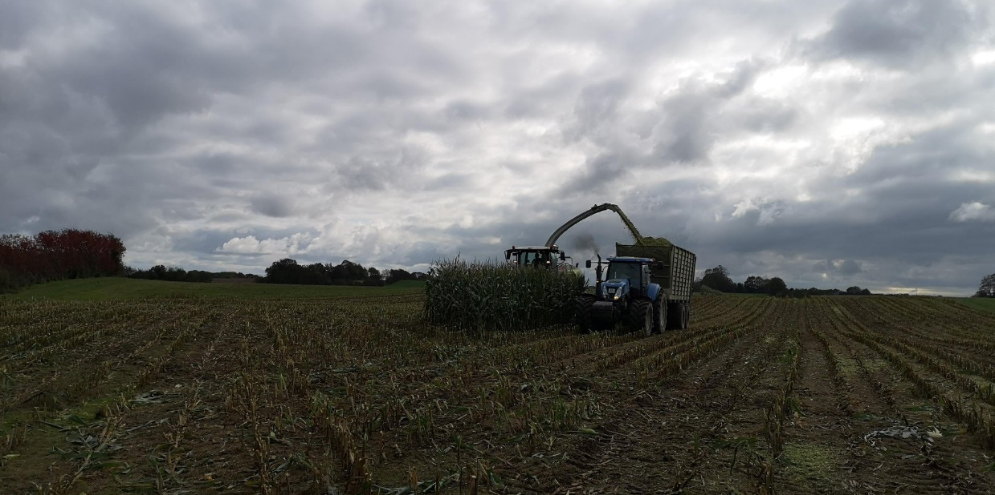
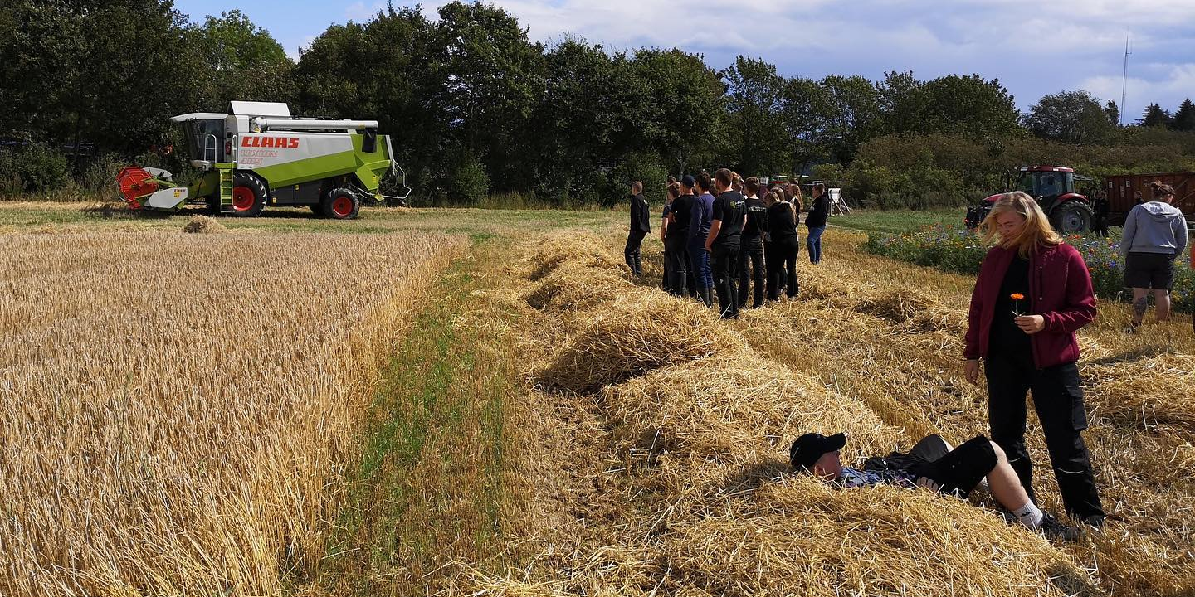
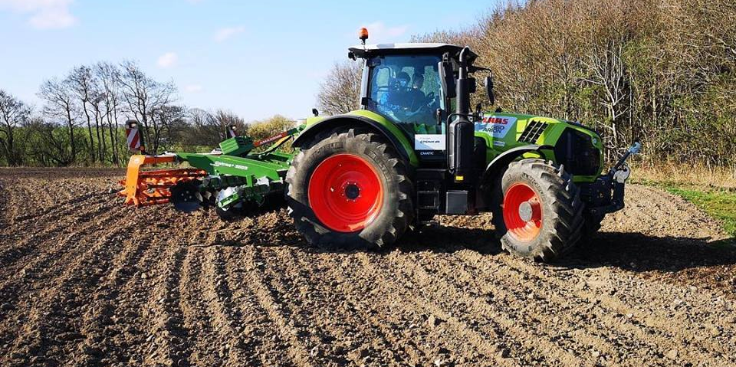
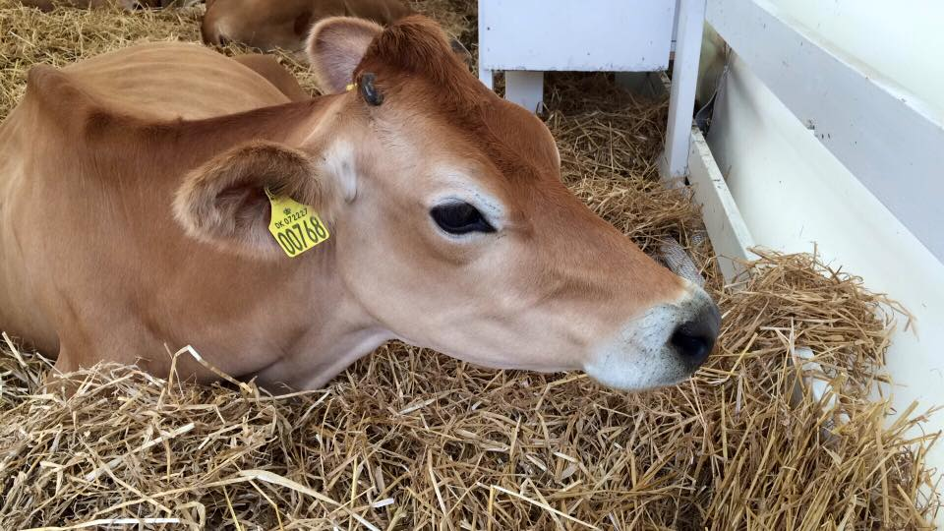
What do we learn?
Machinery
Maintaining
How to drive and use different kinds of machinery
Different types of technologies
Safety
Communication and more
Animals
Take care and feeding animals
Milking, hooftrimming, medication and cleaning
Observing the animals
Heat time
Much more

Slide 9
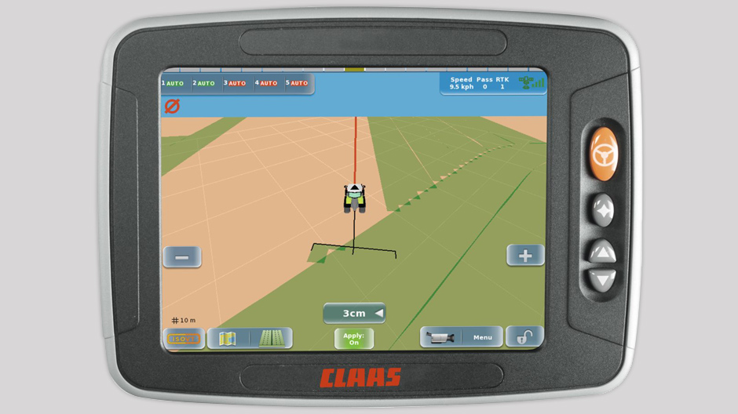
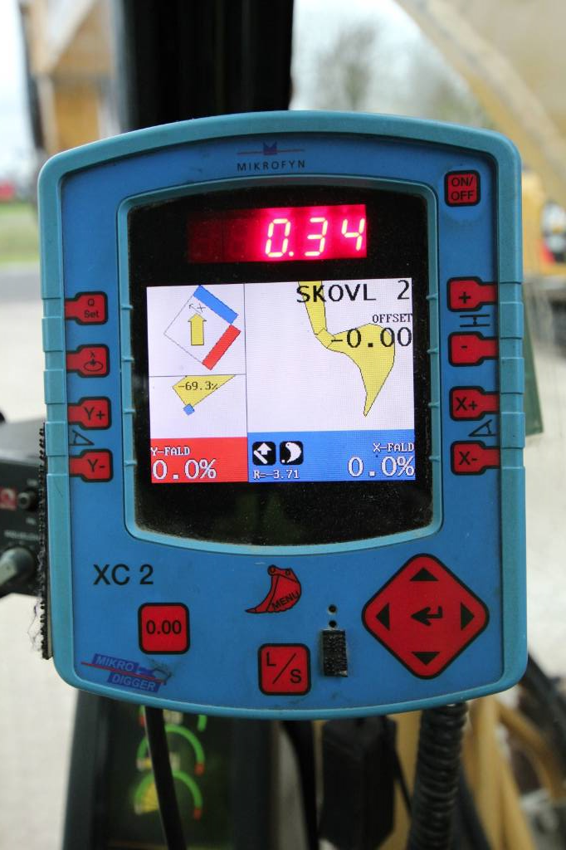
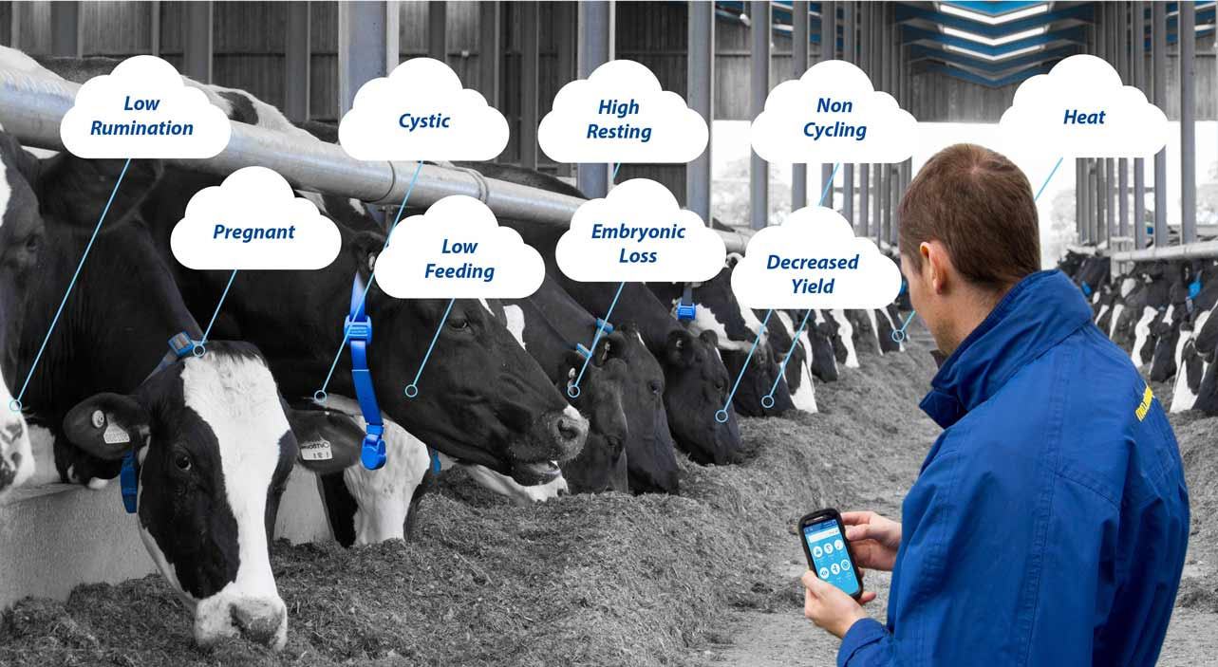
Some of the technologies
GPS
Mikrofyn
Heat time

Slide 10
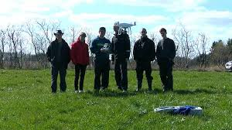
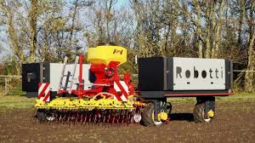
More technologies at green academy Århus
We have five drones
Green Academy has a Cooperation with a robot business named Agrointelli
https://www.tlandmaend-og-gav2ostjylland.dk/artikel/fremtidens-rtnere-laerer-flyve-med-droner

Slide 11
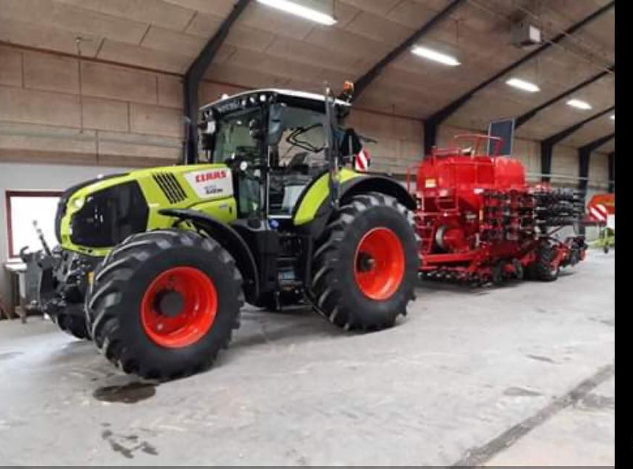
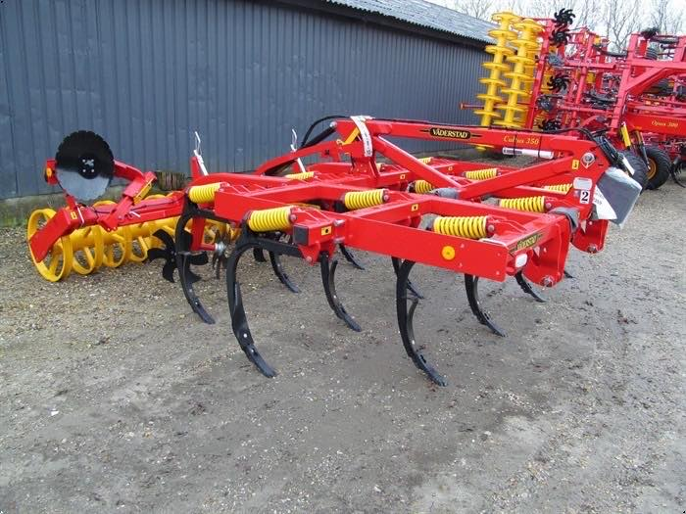
Trials and challenges
Direct seeding without ploughing
A lot of wet land
Difficulties with planting our wheat

Slide 13
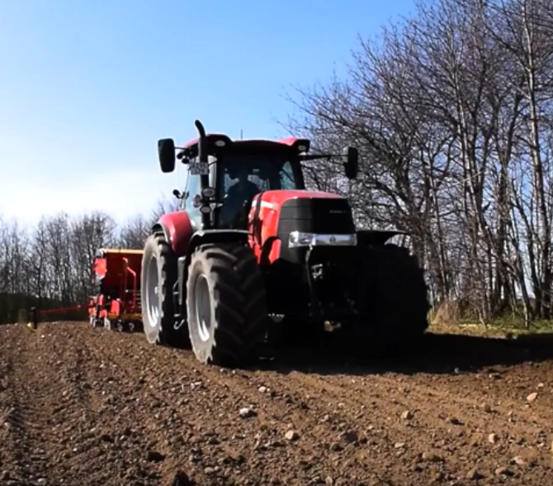
Video from the school
https://www.youtube.com/watch?v=7PGzaUZSnSU

